Slide 1
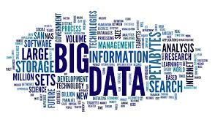
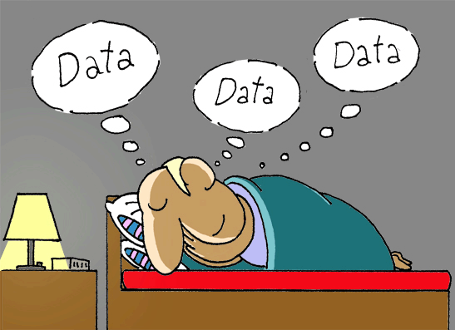
Unit 5. Research Data
M.Phil. Course: Research Methodology and Computer Applications

Slide 2
What is Data
Data Is...more than just data!
Data is plural of datum.
Data is defined as a reinterpretable representation of information in a formalized manner suitable for communication, interpretation or processing.
Data is thought to be the lowest unit of information from which other measurements and analysis can be done.
Data in itself cannot be understood and to get information from the data one must interpret it into meaningful information
Data can be defined as the quantitative or qualitative values of a variable.
Data can be numbers, images, words, figures, facts or ideas.

Slide 3
Data is the basic unit in statistical studies.
Statistical information like census, population variables, health statistics, and road accidents records are all developed from data.
Types of data include:
observational data
laboratory experimental data
computer simulation

Slide 4
Sources of Data
The sources of data may be classified into
Primary Sources: Primary sources are original sources from which the researcher directly collects data that have not been previously collected. Primary data are first hand information collected through various sources and methods.
Secondary Sources: These are sources containing data which have been collected and compiled for another purpose. Researchers may be used for their studies.

Slide 5
Data Collection Techniques
There are two techniques of data collection or data mining -
Primary data
Secondary data
Primary data collection uses surveys, experiments or direct observations.
Secondary data collection may be conducted by collecting information from a diverse source of documents or electronically stored information, census and market studies.

Slide 6
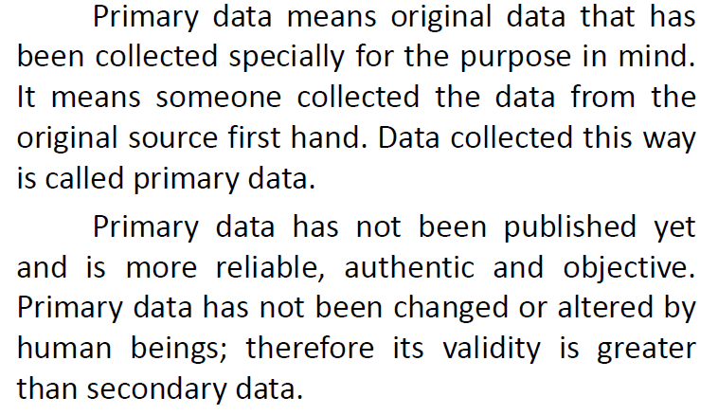
Primary Data

Slide 7
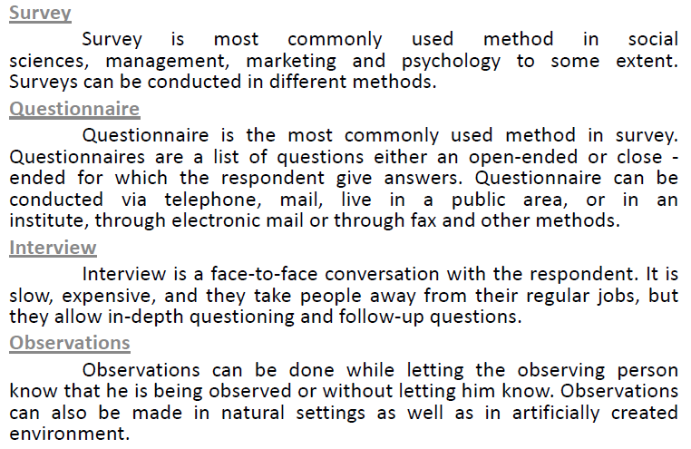

Slide 9
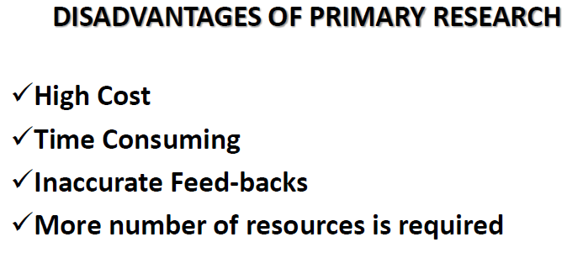

Slide 10
Secondary Data
Secondary data is the data that has been already collected and readily available from other sources.
Secondary data are the data collected by a party not related to the research study. If the researcher uses these data then these become secondary data for the current users.
When we use Statistical Method with Primary Data from another purpose for our purpose we refer to it as Secondary Data.
Such data are more quickly obtainable than the primary data.
These may be available in written, typed or in electronic forms.

Slide 11
A variety of secondary information sources is available to the researcher gathering data on an industry, potential product applications and the market place.
Secondary data is also used to gain initial insight into the research problem.
Secondary data is classified in terms of its source – either internal or external.
Internal (in-house data) is secondary information acquired within the organization where research is being carried out.
External secondary data is obtained from outside sources.

Slide 12
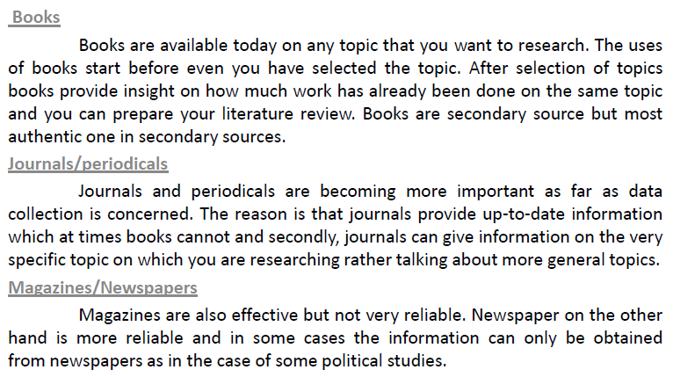
Published printed sources

Slide 13
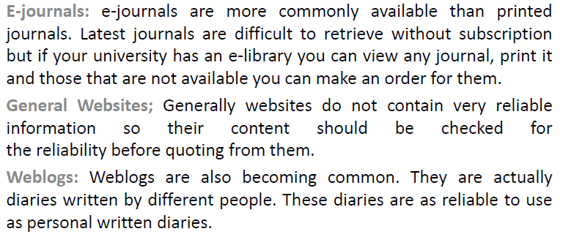
Published electronic sources

Slide 16
Nature of Data: Quantitative and Qualitative

Slide 17
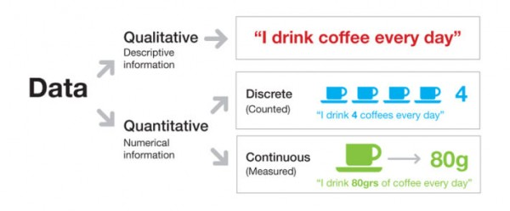

Slide 18
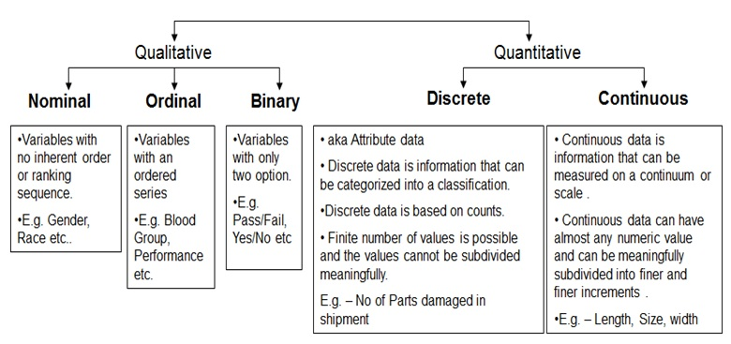

Slide 19
Steps of Data Collection

Slide 20
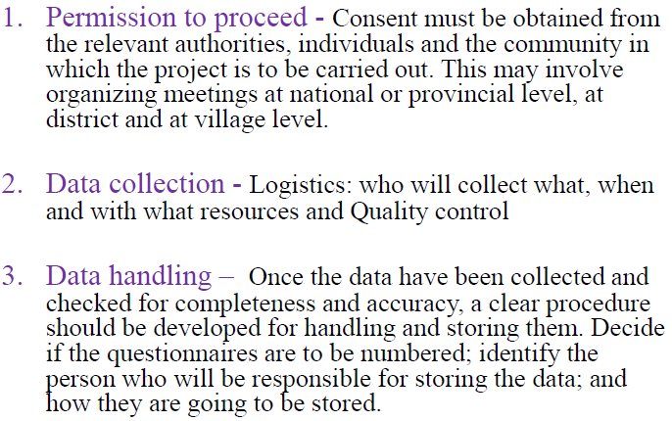

Slide 21
Logistics of data Collection
WHO will collect WHAT data?
When allocating tasks for data collection, it is recommended that you first list them. Then you may identify who could best implement each of the tasks.

Slide 22
Logistics of data Collection
How long will it take to collect data?
Step 1: Consider:
1.The time required to reach the study area(s);
2.The time required to locate the study units (persons, groups, records).
Step 2: Calculate the number of interviews that can be carried out per person per day.
Step3: Calculate the number of days needed to carry out the interviews. For example:
You need to do 200 interviews,
Your research team of 5 people can do 5 x 4 = 20 interviews per day,
You will need 200:20 = 10 days for the interviews.

Slide 23
Logistics of data Collection
Step 4: Calculate the time needed for the other parts of the study, (for example, 10 days)
Step 5: Determine how much time you can devote to the study.

Slide 24
Logistics of data Collection
When should the data be collected?
The type of data to be collected and the demands of the project will determine the actual time needed for the data to be collected. Consideration should be given to:
Availability of research team members and research assistants,
The appropriate season(s) to conduct the field work (if the problem is season-related or if data collection would be difficult during certain periods),
Accessibility and availability of the sampled population, and
Public holidays and vacation periods.

Slide 25
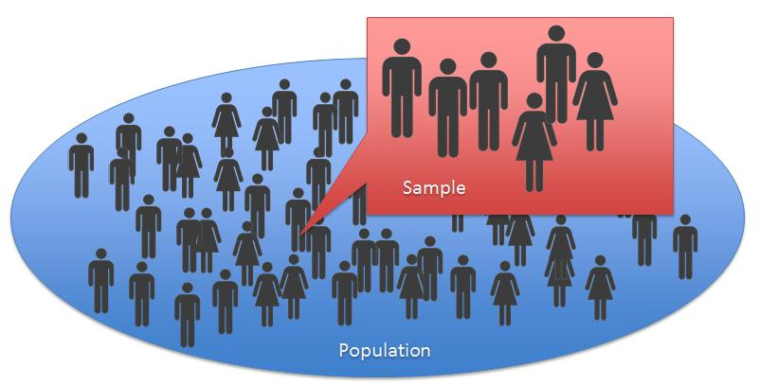
Sampling: A sub-set of the population
Population is a very large number of persons or objects or items which is not feasible to manage.
A population is a group of individuals, persons, objects, or items from which samples are taken for measurement.
For research purpose a part of the population is to be selected.

Slide 26
Sampling
Sampling is the process in which a representative part of a population for the purpose of determining parameters or characteristics of the whole population is selected. This is called a sample.
It is easier to contact a smaller part of the population for data collection. It can be done within a limited time, efforts and with minimum cost.
For selection of a sample special care should be taken that the sample is proper representative of the whole population.
Every segment of the population should be included but the number should not be very large which may become difficult to manage within time and cost limits.

Slide 27
Data Analysis and Interpretation
The purpose of analysing data is to obtain usable and useful information.
The analysis, irrespective of whether the data is qualitative or quantitative, may:
describe and summarise the data
identify relationships between variables
compare variables
identify the difference between variables
forecast outcomes

Slide 28
SCALES OF MEASUREMENT
Many people are confused about what type of analysis to use on a set of data and the relevant forms of pictorial presentation or data display.
The decision is based on the scale of measurement of the data.
These scales are
Nominal
Ordinal
numerical

Slide 29
Nominal scale
A nominal scale is where the data can be classified into a non-numerical or named categories, and non-inherent order in which these categories can be written or asked is arbitrary, e.g. gender, race, etc.
Ordinal scale
An ordinal scale is where the data can be classified into non-numerical or named categories and an inherent order exists among the response categories. Ordinal scales are call for ratings of quality (for example, very good, good, fair, poor, very poor) and agreement (for example, strongly agree, agree, disagree, strongly disagree).
Numerical scale
A numerical scale is where numbers represent the possible response categories there is a natural ranking of the categories zero on the scale has meaning there is a quantifiable difference within categories and between consecutive categories.

Slide 30
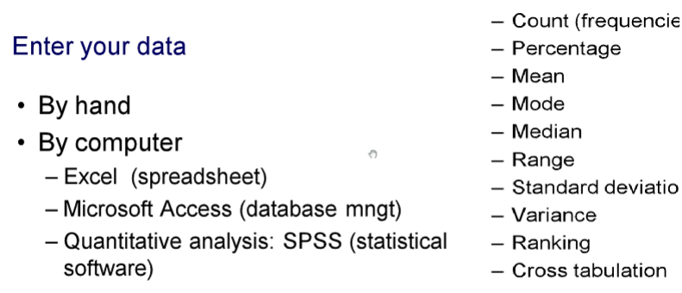

Slide 31
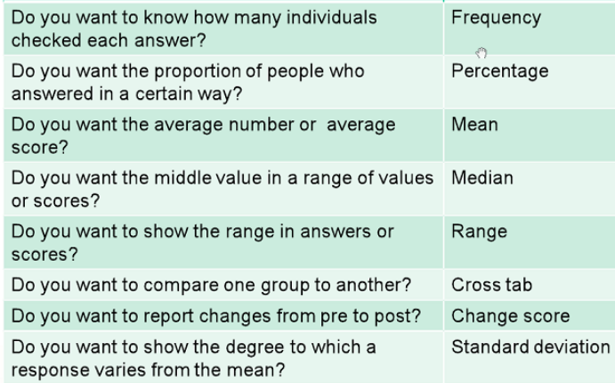
Types of Calculation

Slide 32
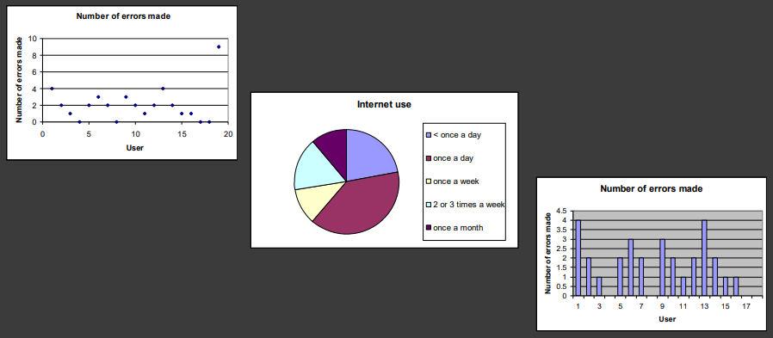
Presentation of Data

Slide 33
Presentation of Findings
Only make claims that your data can support
The best way to present your findings depends on the audience, the purpose, and the data gathering and analysis undertaken
Graphical representations (as discussed above) may be appropriate for presentation

Slide 34
THANK YOU

